Slide 1
RETAIL & CUSTOMER ANALYSIS
BY JOSEPHE RIANNE C. GONZALES

Slide 2
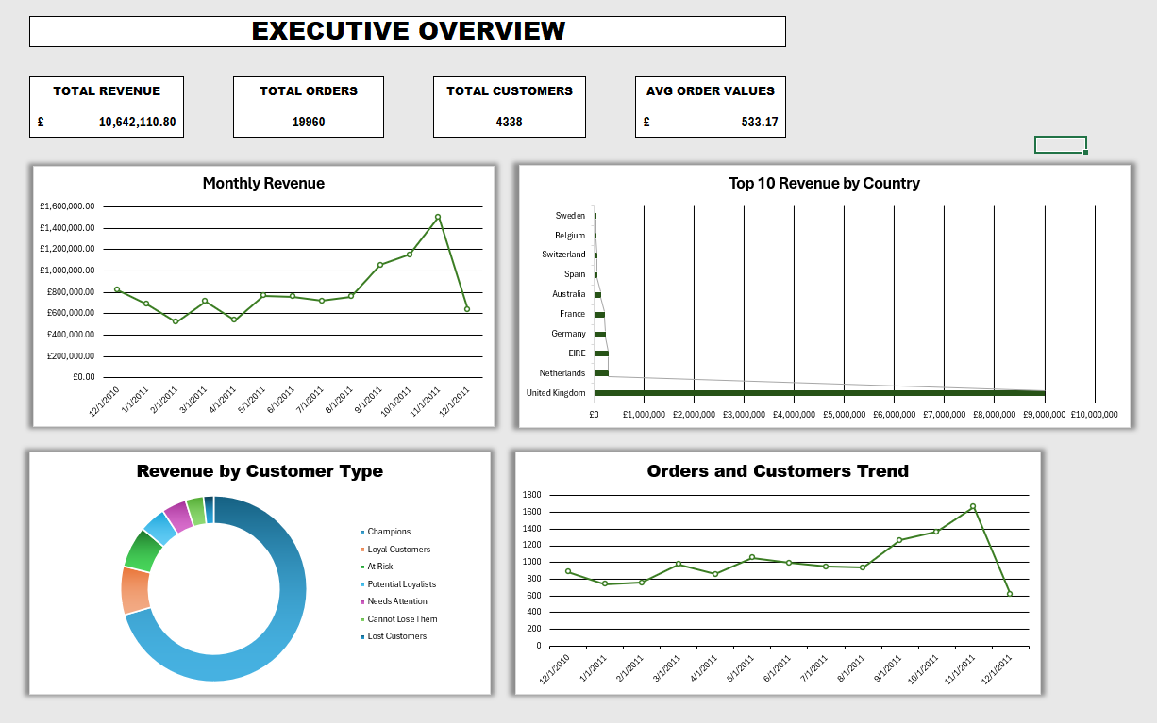
EXECUTIVE OVERVIEW

Slide 3
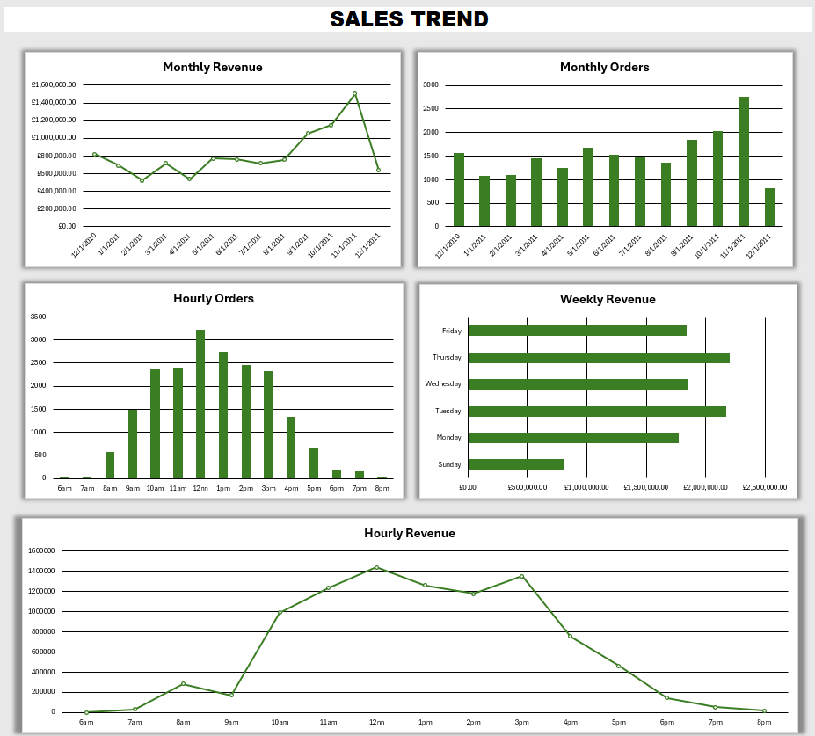
SALES TREND

Slide 4
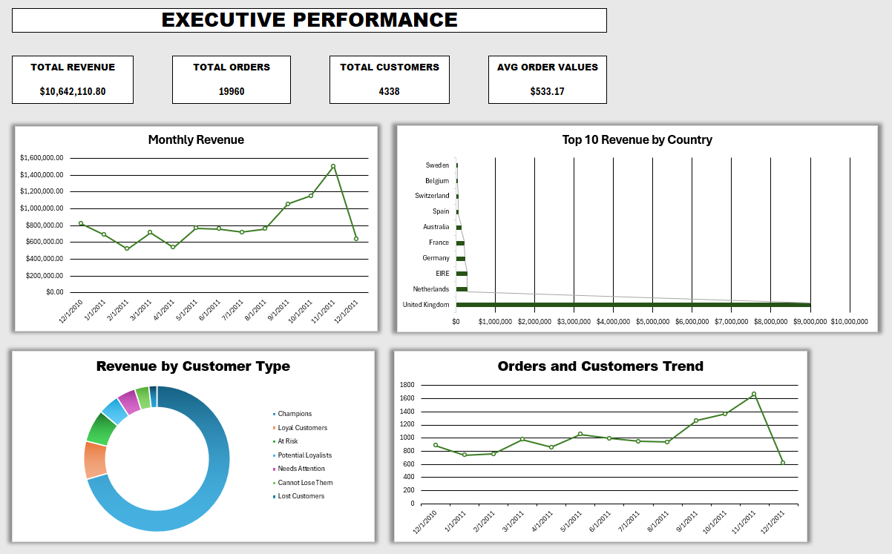
CUSTOMER INTELLIGENCE

Slide 5
PRODUCT & MARKET

Slide 6
RETENTION ANALYSIS

